Slide 1
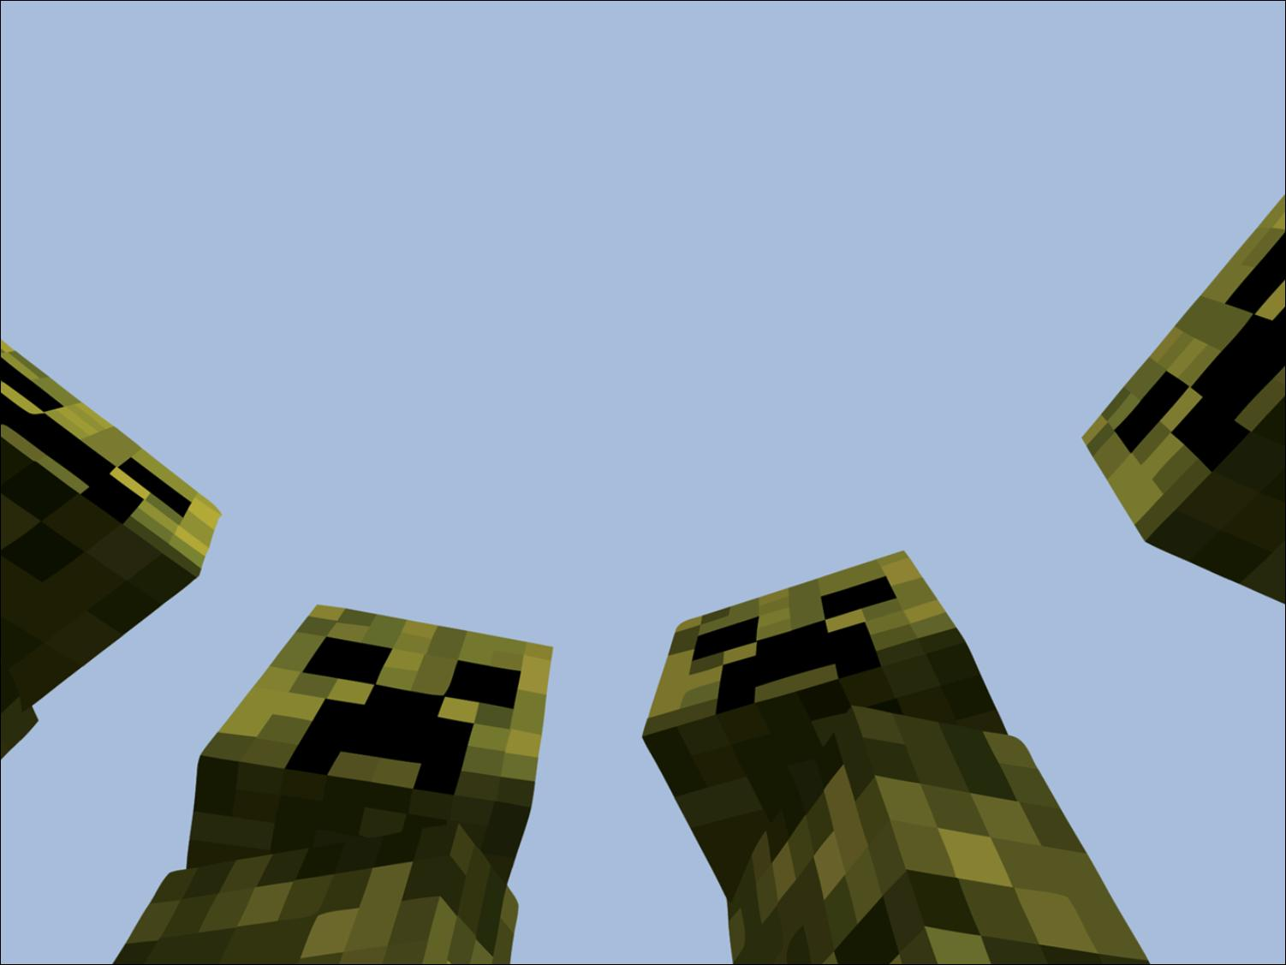
MyFavs
-The Creepers
T.J. Moats, Drew Jackson, Josh Devinney, Devin Mullennix, Matthew Brannick, and William Casey

Slide 2
Design Problem
To create a software comprised of a 3 tier-architecture made of a database, server, and GUI.
We must implement the Java Database Connector to link a MySQL database to our servlet which can in turn be accessed by the client side programs.

Slide 3
Our Approach
Web & Desktop focus
  Make them look the same
Single Database for both
  Desktop app connects to the servlet

Slide 4
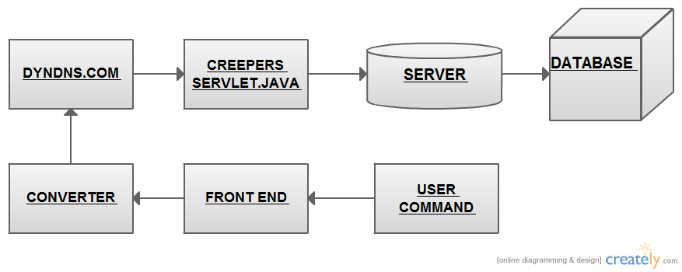
Design Overview

Slide 5



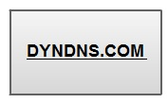
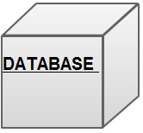


Software Architecture
GUI
Desktop app & myfavs website
Inbeded Jscript & myfavscc.java
DNS hosting server
Connector Class
Ubuntu 10.10 & Apache Tomcat
MySQL Database

Slide 6
Database Design
[See Data Dictionary]
Tables:
  Song (song_id, name, artist_id, album_id, track_number)
  Artist (artist_id, name)
  Album (album_id, artist_id, name)
  Playlist (playlist_id, member_id, name)
  Playlistsong (playlistsong_id, playlist_id, song_id, track_number)
  Member (member_id, username, password)

Slide 7
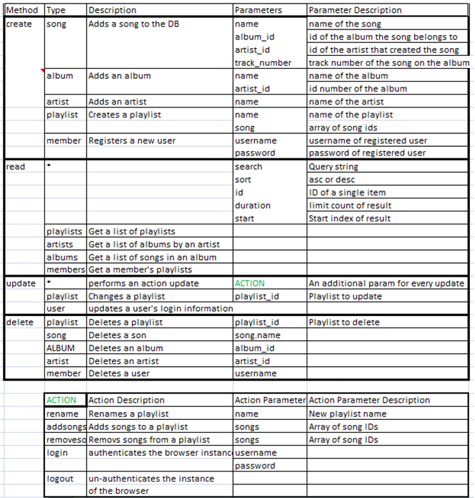

Slide 8
Data Interchange
4 functions
  Create
  Read
  Update
  Delete
Data passed in URL
  Specifies method and object parameters through a JSON object

Slide 9
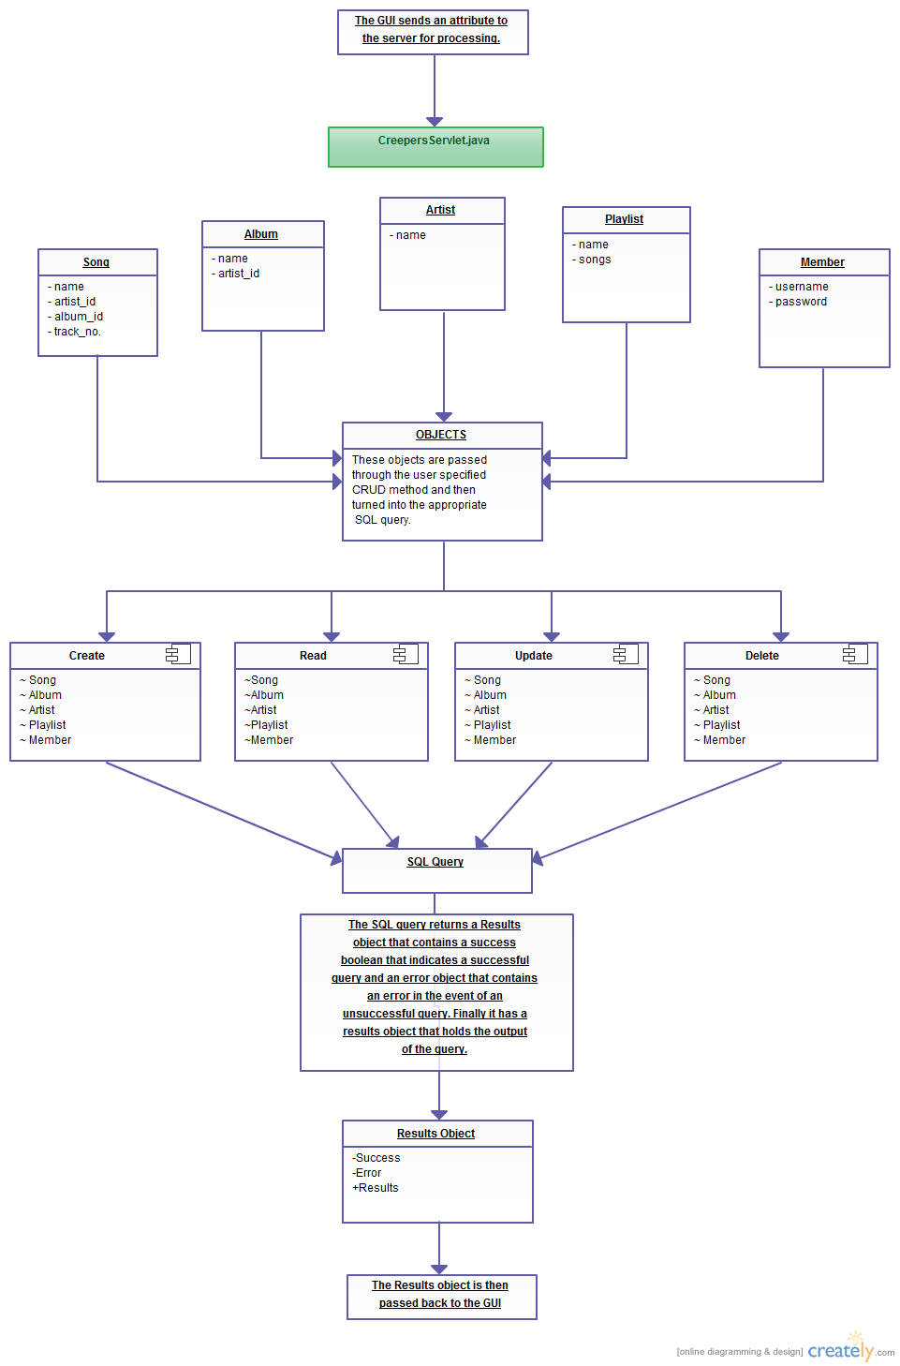

Slide 10
Application Service Design

Slide 11
GUI Best Practices

Slide 12
Usability Problems and Defect Management

Slide 13
WOW Factor

Slide 14
Future Research
Handling of multiple sessions at one time
  Server stability and response issues

